Slide 1
MINNEMUDAC 2026 | GRADUATE DIVISION
Demand is What We See.
Need is What We Miss.
Recorded food-shelf activity in Minnesota follows population and the network. Need, measured two different ways, barely moves it. Here is where the gap is, why it is there, and what August 2026 looks like.
Data Detectors · Valentino, Dhyan, Uddam · 17 October 2026
Notes:
15 seconds. One sentence: we looked at where need and recorded activity disagree, what moves activity over time, and what to expect in August. TODO: confirm full names and order of presenters.

Slide 2
SIX QUESTIONS, SIX ANSWERS
What we found, before the detail
Q1
Need vs. activity
Q6
A measure of need
Q4
Food prices
Counts agree; rates do not. Per resident, recorded activity does not track the food-insecurity rate. The mismatch is worst in Wilkin, Nicollet and Pope.
A falsifiable definition, an index of seven inputs that are not demand. It and Map the Meal Gap disagree on who is in need, and neither predicts activity.
Prices explain little. The real patterns are a 20% seasonal swing (October peak) and one 20% step in March 2023 that prices cannot cause.
Q5
SNAP
Q7
August 2026
Q8
Low-access areas
Demand stepped up about 19% in March 2023 almost everywhere, but not more where more people were on SNAP. No evidence of substitution.
242,000 households, 12.9 million pounds, 746,000 individuals statewide. A pooled May-to-July ratio beat five other transparent methods on three backtest years.
Food shelves reach urban low-access tracts as well as anywhere (98% within five miles) and rural ones worst of all (37%). The network repeats the retail gap.
Notes:
30 seconds. Read the two bold phrases that matter: counts agree, rates do not; the network repeats the retail gap. Everything else is on the slides that follow. Numbers: Q7 from outputs/prediction/Graduate_Predictions_Submit.csv; Q8 from outputs/tables/q8_population_weighted_coverage.csv.

Slide 3
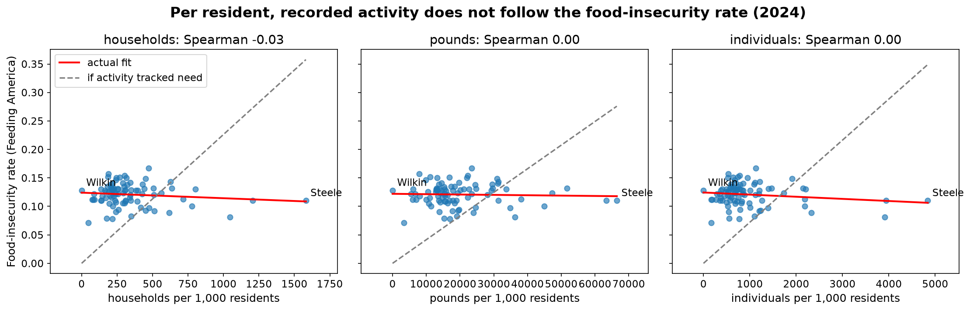
QUESTION 1 · NEED VS. RECORDED ACTIVITY
Valentino
Counts agree with need. Rates do not.
Counts: tight, and steeper than 1:1
A county with 10× the food-insecure people records about 16× the activity.
Log-log slope 1.15 to 1.24, every interval above 1; R² 0.84 to 0.88, every year, every metric.
Rates: nothing
Per 1,000 residents, Spearman with the food-insecurity rate is −0.03 to 0.17.
Pounds tracks need best, households worst, by a small, consistent margin of about 3 points of R².
Where it breaks down
Least activity for its need: Wilkin (no reporting food shelf), Nicollet, Pope, Lac qui Parle. Most: Steele, Washington, Rice.
Distance, rurality, no-vehicle and SNAP households explain 3% of the gap; none is clearly associated. The gap partly measures the network: counties with more sites record more per food-insecure person.
Sources: outputs/tables/q1_loglog_fits.csv, q1_correlations.csv, q1_residual_ranking.csv, q1_covariate_model.csv. Figure: 2024, 86 counties, Feeding America Map the Meal Gap 2026.
Notes:
40 seconds. The chart: each dot is a county in 2024; the x axis is recorded activity per 1,000 residents, the y axis the Feeding America food-insecurity rate. The grey dashed line is where the dots would sit if activity tracked need; the red fit is flat. In raw counts the two agree closely, and more than proportionally: slope 1.15 to 1.24, so bigger counties record more per food-insecure person. Per resident the relationship disappears. Pounds is the metric closest to need, households the furthest, by a small, consistent margin. Wilkin, Nicollet and Pope record the least relative to their need; Steele and Washington the most. The four characteristics the brief names explain 3% of that mismatch. Distance is the one worth following, and Q6 does.

Slide 4
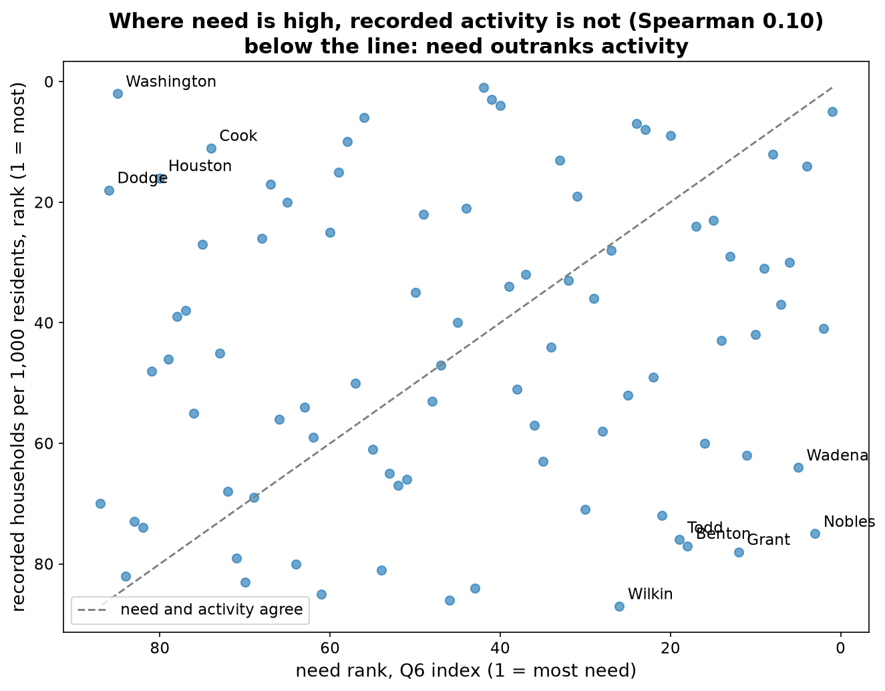
QUESTION 6 · A FALSIFIABLE MEASURE OF NEED
Valentino
Define need before looking, then let the data argue
THE DEFINITION, WRITTEN ON 1 OCTOBER BEFORE THE INDEX EXISTED
A household is in need if, at any point in the past year, it worried about running out of food, regardless of whether it sought help.
The county index: seven inputs, equal weight
Households on SNAP · no vehicle · senior poverty · housing-cost burden · no diploma · low-income low-access share · debt in collections.
Each is measurable at zero demand and is not a Map the Meal Gap input. Barriers to reaching a food shelf (distance, rurality) stay out of the index and are used only to explain the gap.
What would prove us wrong
Reject: a household survey (USDA item 1) ranks counties differently.
Revise: the index collapses onto poverty (R² ≈ 0.9), one input dominates, or the top ten changes when weights change.
Test passed: Wilkin was predicted near the 70th percentile of need; it landed at the 71st.
Need rank against activity rank, 86 counties. Spearman 0.10: knowing a county's need tells you almost nothing about how much activity it records. Below the line, need outranks activity: Nobles, Grant, Wilkin, Benton, Wadena. Above it: Washington, Dodge, Cook.
Sources: questions/q6_divergence_measure/addendum.md; outputs/tables/q6_need_index.csv, q6_divergence.csv, q6_stability.csv. Top seven on need hold under every alternative weighting.
Notes:
40 seconds. The definition is the first item of the USDA food-security survey, so a survey can measure it and disagree with us: that is what makes it falsifiable. It is about the household's experience of food, not about whether it visits a food shelf. The index ranks counties; it does not estimate the share in need, only a survey can. Equal weights, seven public inputs, none of them demand and none an input to Map the Meal Gap. Before the index existed I wrote down where Wilkin should land; it landed one percentile off. The chart: need rank against activity rank; if activity followed need the dots would sit on the line. They do not. Least confident input: debt in collections, which covers only people with a credit file.

Slide 5
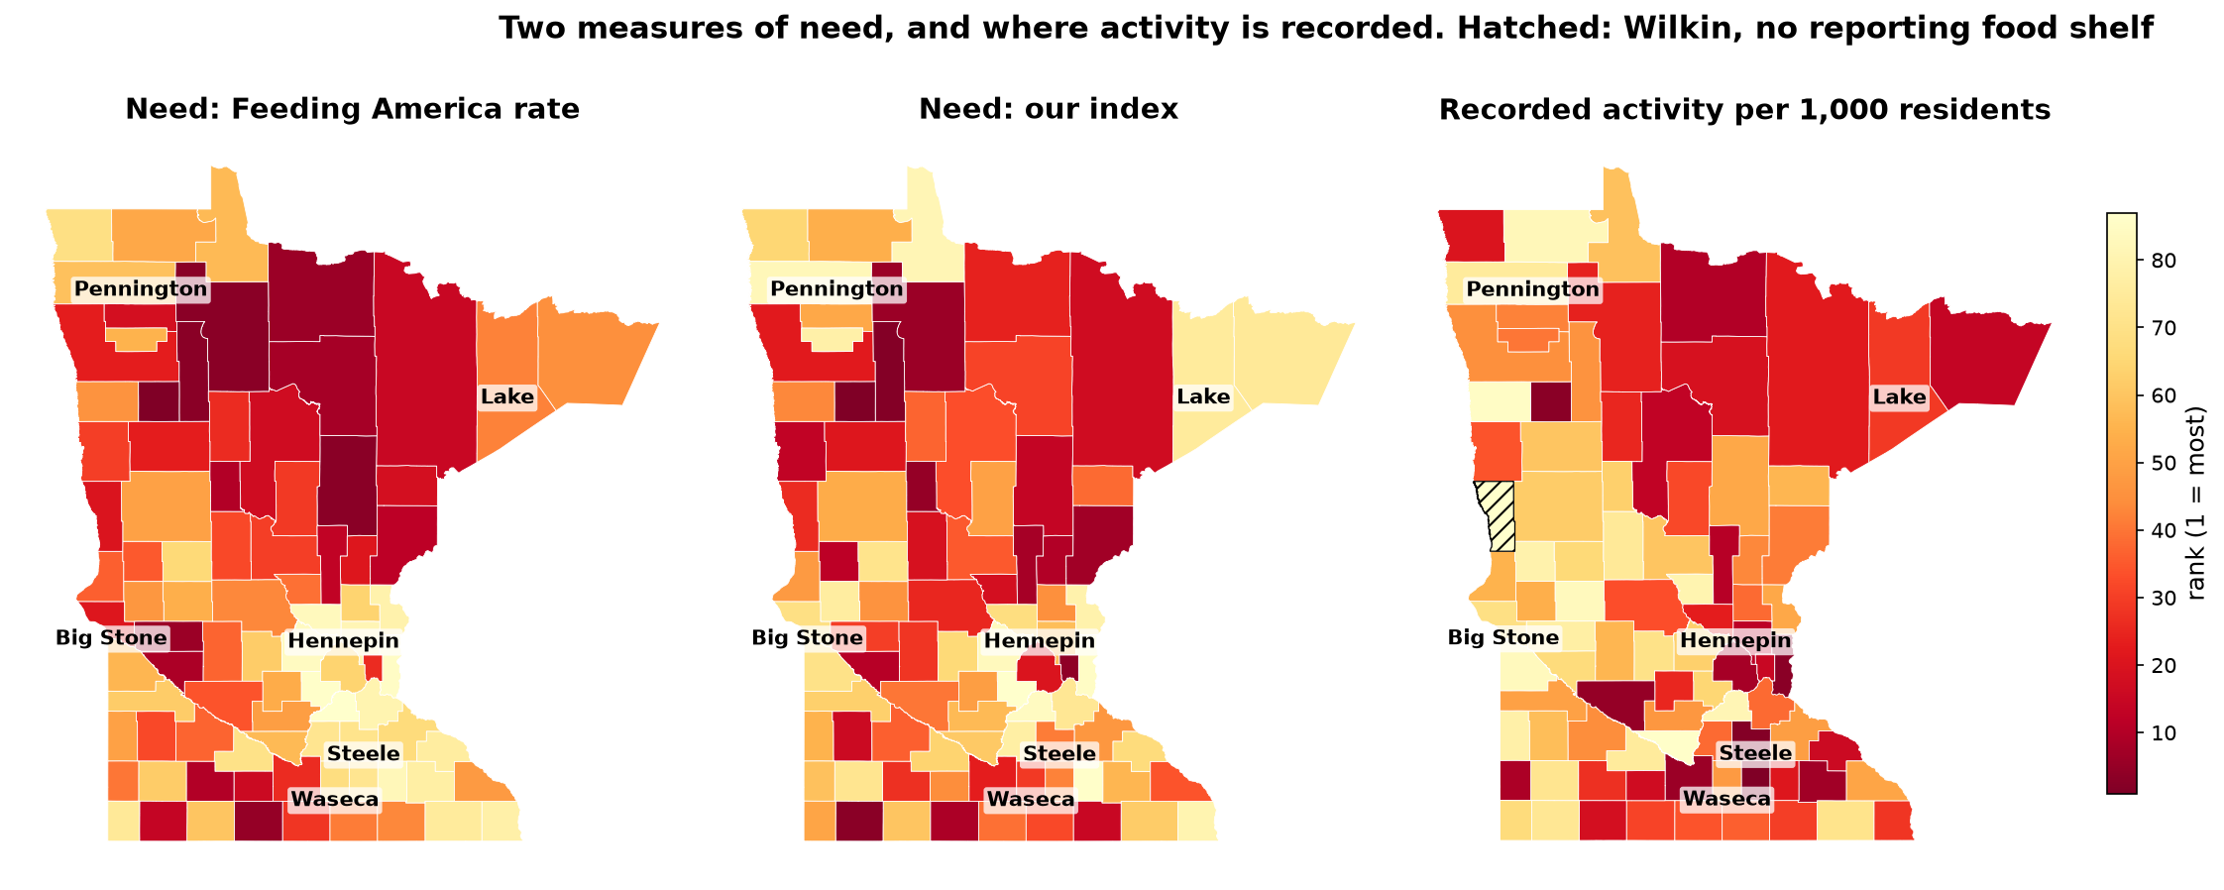
QUESTION 6 · WHERE NEED IS, AND WHERE ACTIVITY IS
Valentino
Two need measures agree; neither matches activity
MMG and the index: broadly the same
Neither predicts activity
What explains the gap: barriers
Spearman 0.77 between the two need rankings. They differ on five of the top ten: MMG finds need where incomes are low, the index where costs and barriers are high.
County size alone explains 85% of recorded activity. Adding MMG or the index adds at most one point of R². Activity follows population, whichever way need is measured.
No internet at home +0.41 per SD (p = 0.005) and distance to a site +0.23 (p = 0.025). Together with rurality and age, 17% of the divergence.
Sources: outputs/tables/q6_vs_mmg.csv, q6_barriers_model.csv (model 'with three more barriers'), q6_barrier_sides.csv. Maps: mean rank 2022 to 2024; hatched = Wilkin, no reporting food shelf.
Notes:
40 seconds. Three maps, same colour scale, darker is more. Left: Feeding America's rate. Middle: our index. Right: recorded activity per 1,000 residents. The two need maps look alike: the north and the west. The activity map does not: it lights up the metro ring and the south. Head to head, county size explains 85% of activity and neither measure of need adds more than a point. The counties where need outranks activity are far from a site and offline: households without internet and distance to a site are the two barriers that explain the divergence, 17% of it. One caution: no-internet is also on the need side of the gap, so part of its effect is need, not barrier. Closing line: recorded activity follows population and sites; need, measured either way, barely moves it.

Slide 6
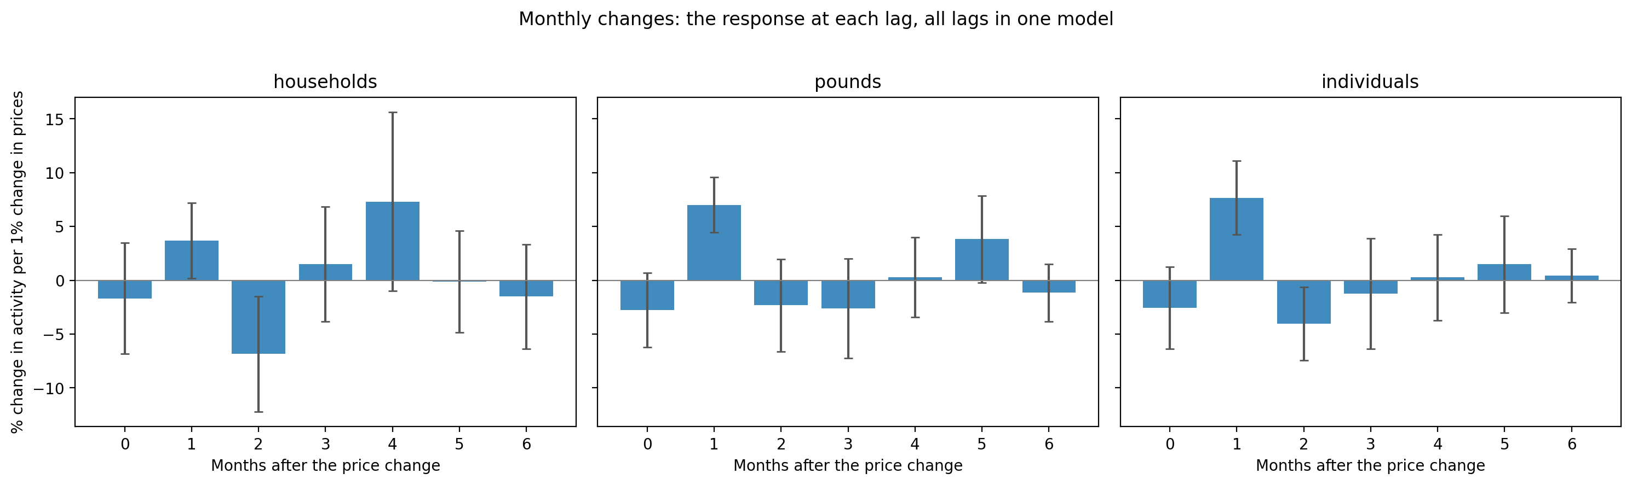
QUESTION 4 · FOOD PRICES
Dhyan
Prices explain little; the calendar explains a lot
Timing: about one month, if at all
Where a response shows, it is one month after the price change, in pounds and individuals, not households.
With SNAP and a trend in the model the price effect drops by a third.
What prices do not explain: the calendar
The 2023 step is not a price story
October is the busiest month and January or February the quietest, in all three metrics: a swing of about 20%, the same every year. That is the pattern a food shelf can plan around.
Pounds per household falls every year (62 in 2022, 50 in 2025): the network spreads less food over more households, so pounds responds to supply, not only to demand.
Activity grew most during the 2022-23 food inflation, but the largest single move is a 20% jump in March 2023: all three metrics, one month.
Prices fell smoothly through 2023 and cannot produce a step.
Sources: Dhyan, notebooks/q4 (dhyan_branch) and outputs/figures/q4_monthly_distributed_lag.png; BLS CPI CUUR0200SAF11 (food at home, Midwest, monthly). TODO Dhyan: confirm the lag-1 coefficient and regenerate the figure from analysis.py.
Notes:
40 seconds, Dhyan. Chart: the response of monthly activity to a 1% change in food-at-home prices at each lag, all lags in one model, month-of-year effects included. Lag 1 is the only bar that clears zero, in pounds and individuals. Levels of prices and activity both trend up, so everything is in changes. The firm findings are the ones prices do not explain: a 20% seasonal swing peaking in October, and a one-month 20% step in March 2023 that Q5 picks up next. TODO: replace the figure with the one analysis.py writes and put the lag-1 coefficient and its interval on the card.

Slide 7
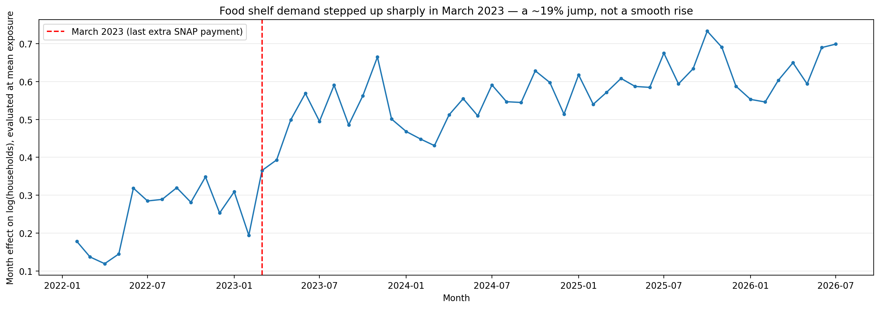
QUESTION 5 · SNAP
Dhyan
March 2023: a 19% step, not larger where SNAP was
The event
Minnesota's last extra pandemic SNAP payment was issued in March 2023; households received the regular benefit only from April.
A dated, national cut, with a different bite in every county.
The design
Event study on 79 SNAP reporting units: unit and month fixed effects, errors clustered on unit.
Two exposure measures (share of people on SNAP before the cut), metro and non-metro separately.
The result
Exposure does not predict a larger rise: coefficients 0.013 and −0.009 (p = 0.42 and 0.33), metro and non-metro alike.
Demand stepped up about 19% in March 2023 in 91% of units (median +18%), regardless of how many of their people were on SNAP. No evidence that food shelves substitute for SNAP; demand rose through 2023 everywhere.
Sources: Dhyan, notebooks/q5 (dhyan_branch), outputs/figures/q5_month_effects_event_study.png; MN DHS county SNAP caseloads (monthly, 79 reporting units). TODO Dhyan: numbers from analysis.py.
Notes:
40 seconds, Dhyan. Chart: month effects on log households at mean exposure, with the last extra SNAP payment marked. The step is there, about 19%, and it is general: nine units in ten rose from February to March 2023. The question the brief asks is whether counties with more people on SNAP rose more. They did not: both exposure measures are near zero and far from significant. So the data give no evidence that SNAP and food shelves substitute for each other; demand rose through 2023 everywhere. Q4 and Q5 agree: March 2023 was a step, prices cannot explain it, and SNAP exposure does not either.

Slide 8
QUESTION 7 · AUGUST 2026 FORECAST
Uddam
What to expect in August 2026, statewide
242,106
12.86 M
746,407
The method, and why
Six transparent candidates backtested on August 2023, 2024 and 2025, each fold using only earlier months.
Winner: pooled May-to-July ratio. Average a county's last three months, scale by its historical August-to-quarter ratio, shrunk toward the statewide ratio. Lowest RMSE on all five scored outcomes.
households
pounds
individuals
264,116
394,811
87,480
children
adults
seniors
Accuracy and the leakage rule
County-level sMAPE in backtests: 12% (households, adults) to 17% (children).
The panel ends July 2026. An independent audit (19 checks, run by a non-author) confirms nothing dated August 2026 enters any input or any backtest fold.
87 county forecasts, five outcomes each, with 80% intervals from backtest errors (about −22% to +13% for Hennepin households). Hennepin alone: 72,769 households. Wilkin has no reporting food shelf and is imputed from rural peers, labelled as such.
Sources: outputs/prediction/Graduate_Predictions_Submit.csv (column sums), outputs/tables/q7_method_selection.csv, q7_forecasts.csv, questions/q7_forecast_august/LEAKAGE_AUDIT.md.
Notes:
40 seconds, Uddam. The six numbers are the statewide sums of the 87 county forecasts we submit. Individuals is the sum of the three age groups, as the brief asks. We tried six transparent methods and chose the one that won on every outcome across three backtest Augusts: average the county's May to July, scale by its August-to-quarter ratio, shrink that ratio toward the state. Accuracy in backtests is 12 to 17% at county level. Open issue for us, not the slide: Hennepin and Anoka's July 2026 bases look like late reporting; if the organizers confirm July is not final, those two forecasts are biased low.

Slide 9
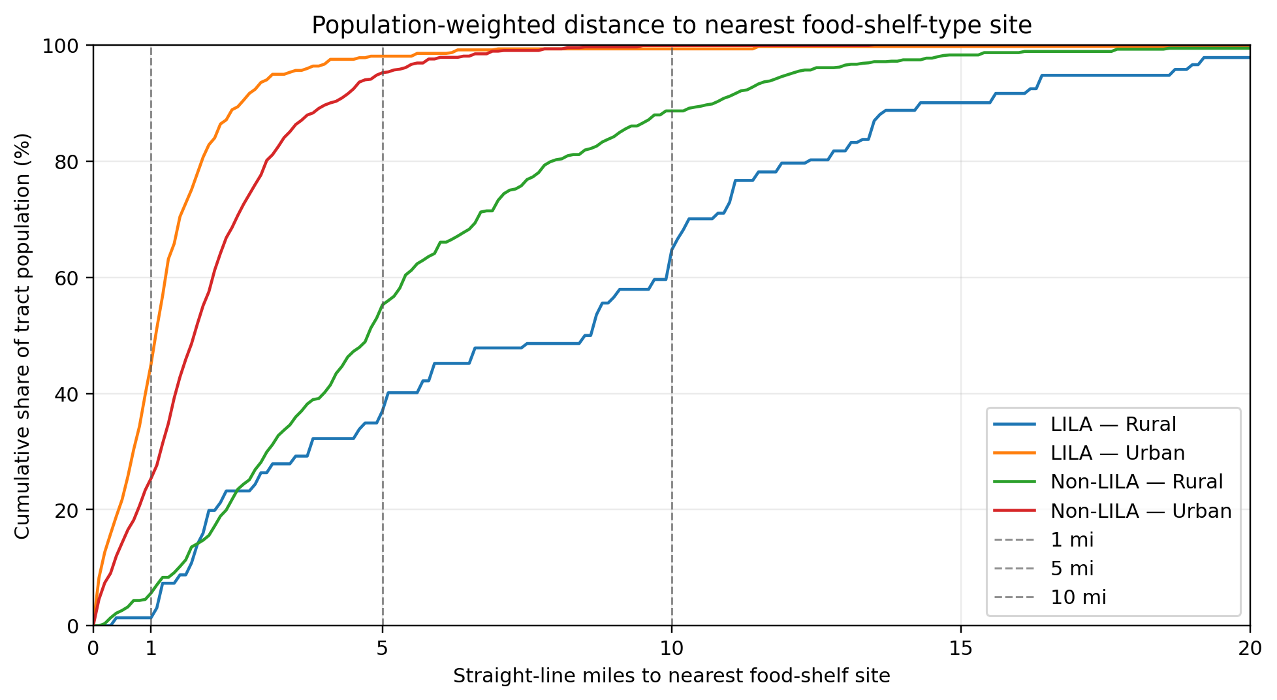
QUESTION 8 · LOW-INCOME, LOW-ACCESS AREAS
Uddam
Fills the gap in cities, repeats it in rural areas
SHARE OF PEOPLE WITHIN 5 MILES OF A FOOD SHELF
98%
95%
urban, low-access (LILA)
urban, other
37%
55%
rural, low-access (LILA)
rural, other
Fill or repeat?
In rural low-access tracts the nearest supermarket averages 9 miles and the nearest food shelf 8: the two networks sit in the same places. Metro-adjacent and remote rural counties look alike (34% and 39% within five miles).
Limitations carried as numbers, not apologies: 2019 USDA flags moved to 2020 tracts by land-area overlap (23 of 1,505 tracts ambiguous); sites placed at tract interior points (median displacement bound 3.1 miles); 402 sites in this definition.
Sources: outputs/tables/q8_population_weighted_coverage.csv, q8_retail_pattern_comparison.csv (OSM supermarkets), q8_rural_adjacency_access.csv. USDA Food Access Research Atlas 2019.
Notes:
40 seconds, Uddam. Chart: for each group of tracts, the share of people living within a given straight-line distance of a food shelf. Urban curves, low-access or not, are at 95% plus by five miles. Rural curves are far below, and the rural low-access curve is the lowest of all: 37% within five miles. So in cities the network reaches low-access areas as well as anywhere; in rural Minnesota it reaches them worse than the rest. Against supermarkets the food-shelf distances are about the same, so the network repeats the retail gap where the gap is biggest. Limitations have magnitudes, on the slide.

Slide 10
THE THROUGH-LINE
Recorded activity follows population and sites. Need, measured either way, barely moves it.
Where it is missing
What moves it over time
What to plan for
Far from a site and offline: Nobles, Grant, Wilkin, Benton, Wadena, and rural low-access tracts statewide.
The calendar (October peak) and one step in March 2023, not prices and not SNAP exposure.
August 2026: 242,000 households and 12.9 million pounds, county by county, intervals included.
Every number traces to a script in github.com/dhyan95/MinneMUDAC. Questions welcome.
Notes:
20 seconds. Say the sentence, then the three bullets as three breaths. Stop.

Slide 11
APPENDIX
Public data sources and why each one
Source | Exact series | Grain | Why this one | Used by
Feeding America | Map the Meal Gap 2025 (2019-23) and 2026 (2024) | county · annual | Mandated by the brief; the only county food-insecurity estimate | Q1, Q6, Q7
Census ACS 5-year | B22003, B08201, B17001, B25070/B25091, B15003, B16002, B28002, B05001 | county · 5-yr | Only source for vehicle, housing-burden, internet and education at county grain | Q6, Q1
USDA ERS | Food Access Research Atlas (LILA flags); RUCC 2023 | tract · 2019; county | The official low-access definition; RUCC is inside MMG | Q8, Q6, Q1
Urban Institute | Debt in America: share with debt in collections | county · 2025 | Financial stress not captured by income; caveat: credit-file population only | Q6
BLS | CPI CUUR0200SAF11, food at home, Midwest | region · monthly | Finest monthly food-price series covering all of Minnesota | Q4
MN DHS | SNAP caseloads by reporting unit | unit · monthly | The only county-grain monthly SNAP series; publication lag noted | Q5
Census | County adjacency file 2023; tract relationship file 2010-2020; Gazetteer | county / tract | Spatial tests (Q1), crosswalk of 2019 flags to 2020 tracts (Q8) | Q1, Q8
USDA FNS / OSM | SNAP retailer locator (to 2025-12-31); Geofabrik MN supermarkets | point | Two independent store sets for the retail-pattern comparison | Q8
Full registry with publication lags and file paths: docs/DATA_SOURCES.md. Nothing dated August 2026 or later enters the repository.
Notes:
Backup slide. Not presented; here for the judges' question on sources.

Slide 12
APPENDIX
Methods, one line each
Q1
Log-log OLS of activity on food-insecure persons per county-year (2022-24); residual ranking; covariate model with clustered errors; Moran's I (0.06, p = 0.37), join counts and pooling tests for spatial pattern.
Q6
Within-year z-scores of seven inputs, equal weights; divergence = need rank minus activity rank; stability under 10 alternative weightings and random (Dirichlet) weights; barrier regression; nested models against MMG.
Q4
Year-over-year changes, distributed lag 0 to 6 months with month-of-year effects; SNAP and trend as controls; residual seasonality.
Q5
Event study on 79 SNAP reporting units: unit and month fixed effects, exposure × post interaction, clustered errors, metro split.
Q7
Six baselines backtested on August 2023-25; pooled May-July ratio shrunk toward the state; 80% intervals from backtest residual quantiles; independent 19-check leakage audit.
Q8
Area-weighted 2010→2020 tract crosswalk; population-weighted distance bands to nearest site; comparison with supermarket distances; urban/rural and adjacency splits; displacement bounds for site locations.
Notes:
Backup slide for method questions.

